Slide 1
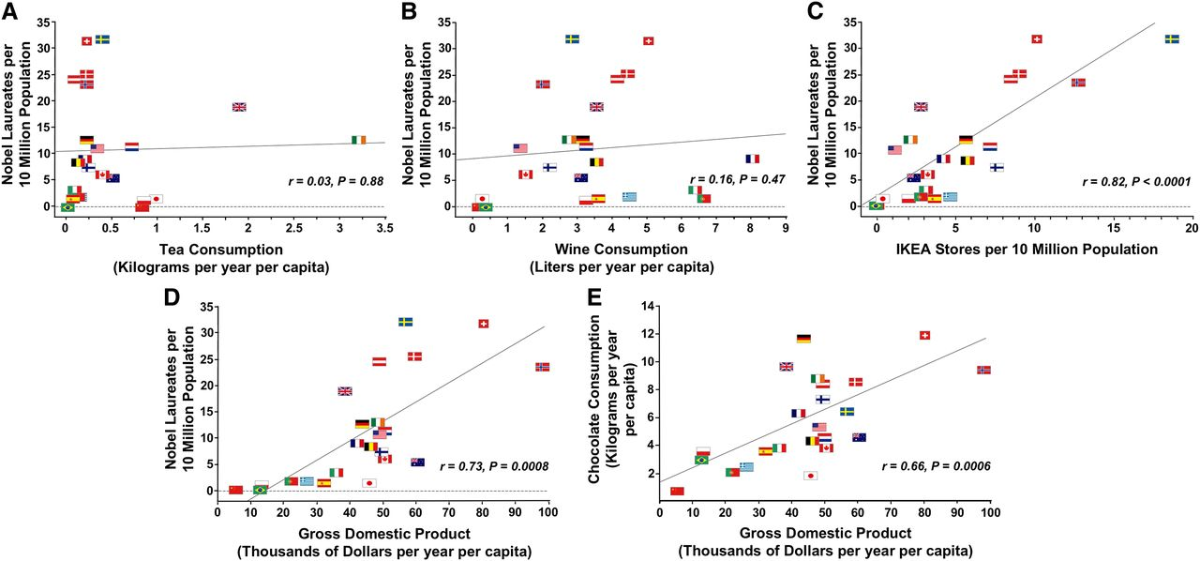
Correlations between countries’ (A) number of Nobel laureates per ten million population and annual per capita tea consumption; (B) number of Nobel laureates per ten million population and annual per capita wine consumption; (C) number of Nobel laureates an...
Pierre Maurage et al. J. Nutr. 2013;143:931-933
©2013 by American Society for Nutrition
Notes:
Correlations between countries’ (A) number of Nobel laureates per ten million population and annual per capita tea consumption; (B) number of Nobel laureates per ten million population and annual per capita wine consumption; (C) number of Nobel laureates and number of IKEA stores per ten million population; (D) number of Nobel laureates per ten million population and annual per capita gross domestic product; and (E) annual per capita chocolate consumption and annual per capita gross domestic product.

